Slide 1
Data Structures and Algorithms Using C++
LU2: Analyze Data Structures and algorithms

Slide 2
2.1 Algorithm Analysis

Slide 3
2.1.1 Introduction: What is an Algorithm?
=>An Algorithm is a finite set of unambiguous steps or instructions to solve a given problem.
=>An algorithm is a set of instructions for solving a problem or accomplishing a task.
=>It can also be defined as a process or set of rules to be followed in calculations or other problem-solving operations, especially by a computer. Knowledge of algorithms helps us to get desired results faster by applying the appropriate algorithm. We learn by experience. With experience, it becomes easy to solve new problems.
The properties of an algorithm are:
1. It takes zero or more inputs.
2. It should produce one or more output.
3. It should be Deterministic. It produces the same output if the same input is provided again.
4. It should be Correct. It should be correct and able to process all the given inputs and provide the correct output.
5.It should Terminate in a finite time.
6. It should be Efficient. The algorithm should be efficient in solving problems.

Slide 4
2.1.2 Algorithm representation:
Natural Language
Pseudocode
Flowchart

Slide 5
2.1.3 Algorithm Complexity
The complexity of an algorithm is the amount of Time or Space required by the algorithm to process the input and produce the output. Algorithm designers strive to develop algorithms with the lowest possible time and space/memory complexities, since this makes them more efficient and scalable.
There are two types of Complexity:
1. First is Time-Complexity, how much time is required by an algorithm to produce output for an input of size 'n'.
Time-Complexity is represented by function T(n) - time required versus the input size n.
2. Second is Space-Complexity, how much RAM or memory that an algorithm is going to
consume to produce output for an input of size 'n'.
Space-Complexity is represented by function S(n) - memory used versus the input size n.
An algorithm is analyzed using Time Complexity and Space Complexity. Writing an efficient algorithm help to consume the minimum amount of time for processing the logic.

Slide 6
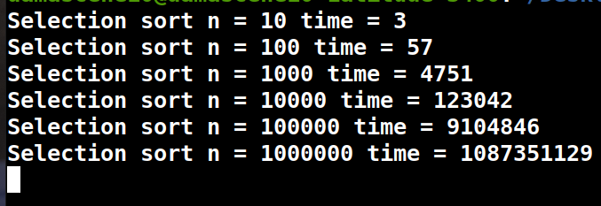
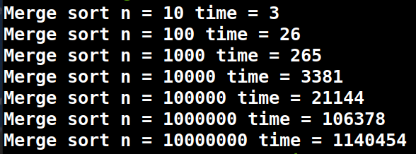
Experimental Analysis
Write code for every solution, record the time and plot the time on the graph. Compile and run the following program for both Merge Sort and selection sort for 10 million elements:
https://shorturl.at/Lb53K
Selection sort: 10.000.000 elements
Merge Sort for 10.000.000 elements
The selection sort to finish sorting 10 Million elements will take 8-10 hours which is very difficult to wait or handle. Experimental analysis is difficult to use.

Slide 7
Theoretical analysis of an Algorithm
They are 3 solutions. Without writing the code, you should be able to tell which is the best and the time complexity of every solution as well as the time function: Asymptotic Analysis or Asymptotic notations

Slide 8
Asymptotic Analysis or Asymptotic notations
Calculating the running time of any algorithm in mathematical units of computation is known as Asymptotic Analysis. The efficiency of algorithms is calculated using asymptotic analysis, independent of the given data set or programming language.
In most cases, we are interested in the order of growth of the algorithm instead of the exact time required for running an algorithm. This time is also known as Asymptotic Running Time.
The performance of an algorithm can change with a change in the input size. That is where Asymptotic Notations like Big O Notation comes into play. Asymptotic Notations can describe an algorithm's run time when the input tends toward a specific or limiting value. Asymptotic analysis helps to analyze the algorithm performance change in the order of input size.

Slide 9
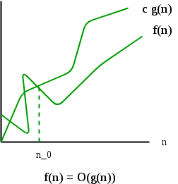
Big O Notation
Formal definition: "f(n) is big-O of g(n)" or f(n) = O(g(n)), if there are two constants c and n1 such that f(n) <=c.g(n) for all n >= n1; in other words, c.g(n) is an upper bound for f(n) for all n>= n₀. The function f(n) growth is slower than c.g(n). For a sufficiently large value of input n, the (c.g(n)) will always be greater than f(n).
Big-O notation in Data Structure represents the upper bound of the running time of an algorithm or the Worst case complexity.
Big O Notation is a tool used to describe the time complexity of algorithms. It calculates the time taken to run an algorithm as the input grows.
Mathematical Representation of Big-O

Slide 10
Big O Notation(next)
The formal definition is useful when you need to perform a math proof. For example, the time complexity for selection sort can be defined by the function f(n) = n²/2-n/2 as we have discussed in the previous section.
If we allow our function g(n) to be n², we can find a constant c = 1, and a N₀ = 0, and so long as N > N₀, N² will always be greater than N²/2-N/2. We can easily prove this by subtracting N²/2 from both functions, then we can easily see N²/2 > -N/2 to be true when N > 0. Therefore, we can come up with the conclusion that f(n) = O(n²), in the other selection sort is “big O squared”.
You might have noticed a little trick here. That is, if you make g(n) grow super fast, way faster than anything, O(g(n)) will always be great enough. For example, for any polynomial function, you can always be right by saying that they are O(2ⁿ) because 2ⁿ will eventually outgrow any polynomials.
Mathematically, you are right, but generally when we talk about Big O, we want to know the tight bound of the function.

Slide 11
Big O Notation for Time Complexity: Example
Consider the case of Bubble Sort. If the array of N is not sorted, To swap two elements it take k amount of time, and this must happen N-1 time; the first element will be swapped with N-1 and take k(N-1) time, the second must be swapped with N-2 elements which means k(N-2), the last element will be swapped with N-N=0=K amount of time.
T(N)=k(N-1)+k(N-2)+k(N-3)+.....+K
T(N)=K(1+2+3+4+.......+n-1) // As per PMI, the sum of n first numbers is ∑n=n(n+1)/2
T(N)=K(N-1)*N/2
T(N)=KN²/2-K(N)
The constant K/2 will be ignored. And keep N²,
This means that the time complexity for Bubble Sort is O(N²).
1 | 2 | 3 | 4 | 5 | … | .. | N

Slide 12
Complexity analysis of algorithms
The complexity of an algorithm are analysed in three categories:
➤ Worst-Case Complexity: The worst-case complexity represents the maximum number of steps required to execute an algorithm. It provides us with the upper bound of an algorithm. Usually, we use this complexity to judge algorithm performance.
➤Best-Case Complexity: The best-case complexity represents the minimum number of steps required to execute an algorithm. It provides us with the lower bound of an algorithm.
➤ Average-Case Complexity: The average-case complexity represents the average number of steps required to execute an algorithm. We take the average of the steps executed in all the cases to calculate average-case complexity.
Note: Worst-case complexity is used to find the guarantee in how much time some particular algorithm will finish. This is the most important time complexity. If the type of complexity is not mentioned, then always consider Worst-Case time complexity.

Slide 13
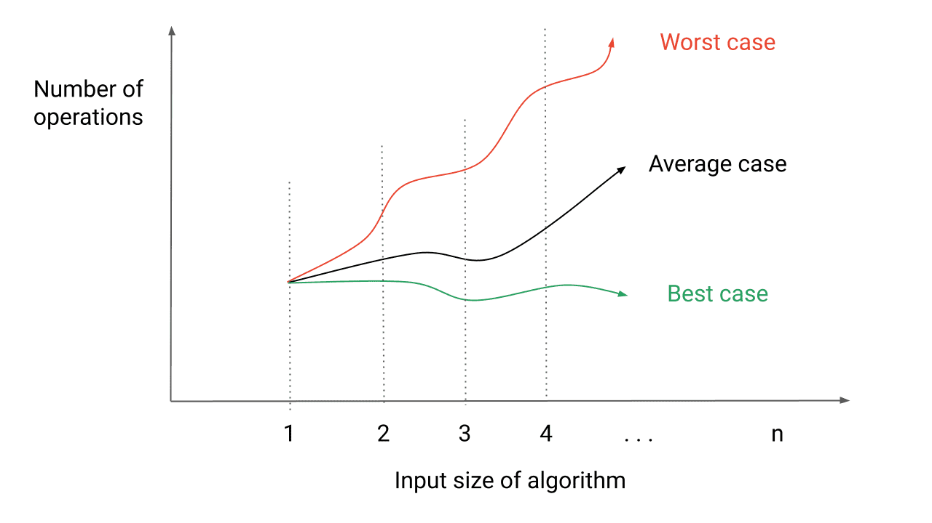
Graphical representation of the Three categories

Slide 14
Growth Functions
Let us look at these growth rates of various functions. The size of input is n
Constant Time, O(1)
An algorithm is said to run in constant time if the output is produced in constant time, regardless of the input size.
Examples: Accessing an n^{th} element of an Array
Linear Time, O(n)
An algorithm is said to run in linear time if the execution time of the algorithm is directly proportional to the input size.
Examples:
1. Array operations like search element, find min, find max etc.
2.Linked list operations like traversal, find min, find max etc.
Note: If we need to traverse all the nodes of a data structure for some task, then complexity cant be
less than O(n)

Slide 15
Growth Functions
Logarithmic Time, O(log(n))
An algorithm is said to run in logarithmic time if the execution time of the algorithm is proportional to the logarithm of the input size. In each step of an algorithm, a significant portion (e.g. half portion) of the input is pruned/rejected out without traversing it.
An example is the Binary search algorithm. We will read about this algorithm later.
n.log(n) Time, O(n.log(n))
An algorithm is said to run in n*log(n) time if the execution time of an algorithm is proportional to the product of input size and logarithm of the input size. In these algorithms, each time the input is divided into half (or some proportion) and each portion is processed independently.
Examples: Merge-Sort, Quick-Sort (average case), Heap-Sort etc.

Slide 16
Growth Functions
Quadratic Time, O(n^2)
An algorithm is said to run in quadratic time if the execution time of an algorithm is proportional to th square of the input size. In these algorithms, each element is compared with all the other elements.
Examples: Bubble-Sort, Selection-Sort, Insertion-Sort
Exponential Time O(2^n)
In these algorithms, all possible subsets of elements of input data are generated. Its common example
is the power set.
Factorial Time O(n!)
In these algorithms, all possible permutations of the elements of input data are generated. Finding permutations is a common example of factorial time.
A list of commonly occurring algorithm Time Complexity in incronin

Slide 17
Commonly encountered time complexities in increasing order
Name | Running Time(Tn)
Constant | O(1)
Logarithmic | O(log(n))
Linear | O(n)
n.log(n) | O(n.log(n))
Quadratic | O(n^2)
Polynomial | O(n^c) c is a constant and c>1
Exponential | O(c^m) c is a constant and c>1
Factorial | O(n!)
N power N | O(n*n)
With Big O Notation:
We ignore constants
Focus on the highest power
Examples
7n²+5n+8=>O(n²)
Because n²>>>>n
n³+n²=> O(n³)
5n^{n}+n³=>O(n^{n})
5n²+n.log(n)=>O(n²)
n+n log(n)=>O(n.log(n))

Slide 18
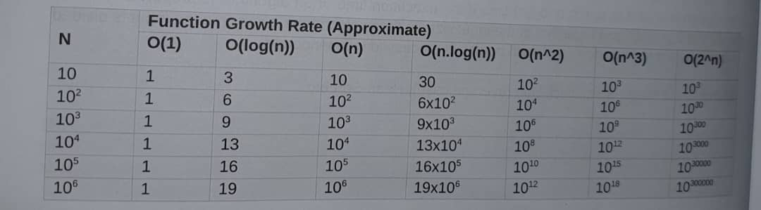
Functions Growth Rate( Approximation)
The time taken by certain algorithms to run varies dramatically with the size of the input. Some algorithms take minutes or even seconds to run on huge input, whereas others may take days to complete their execution. To understand how the rate of growth changes with the size of the input in different functions, the following table presents the approximate number of steps required to run an algorithm

Slide 19
Deriving/Hints an Algorithm's Runtime Function
Constants
If any line of code is a statement with basic operations, e.g., comparisons, assignments, or reading a variable, they take constant time each. Thus, the time complexity of each statement is O(1).
Loops
In loop, a repetition of a particular code for n times, where n is the size of the loop. Every statement inside the loop has a runtime of O(1). The running time of a loop is a product of the running time of the statement inside a loop and the number of iterations in the loop. Time Complexity is O(n)
Nested Loops
The running time of nested loops is a product of the running time of the statements inside the loop multiplied by a product of the size of all the loops. Time Complexity is O(n^c). Where c is the number of loops. For two loops, it will be O(n^2)
Consecutive Statements
In this case, we add the running time of all the consecutive lines of code.
If-Else Statement
In this case, either "if" will run or "else" will run. So, the block with larger runtime will be considered.
Deriving an Algorithm's Runtime Function
Logarithmic Statement
In this case, each iteration will cut the input size into b pieces and consider one of the pieces for the next iteration. Time complexity in this situation will be O(log(n)).

Slide 20
Time Complexity Examples
Example 2.2: Nested loops
#include <iostream>
using namespace std;
int fun6 (int n) {
int m = 0;
for(int i=0;i<n;i++){
for(int j=0;j<n;j++){
m += 1;
}
}
return m;
}
// Testing Code
int main() {
std::cout << "N = 100, Number of instructions O(n^2)::fun2(100);
return 0;
}
Output:
N = 100, Number of instructions in 0(n^2)::10000
Time Complexity: O(n^2), two nested loop, takes quadratic time. Both the loop is executed in number
of times, so the internal statement executed n^2 number of times
Example 2.1: Single loop
int fun1(int n) {
int m= : 0;
for (int i = 0; i<n; i++) {
m += 1;
}
}
return m;
}
// Testing Code
int main() {
std::cout<<"N = 100, Number of instructions 0(n) :: " << fun1(100);
return 0;
}
Output:
N = 100, Number of instructions in 0(n): :100
Time Complexity: O(n), single loop takes linear time

Slide 21
Time Complexity Examples
Example 2.4: Arithmetic Progression
#include <iostream>
using namespace std;
int fun6 (int n) {
int i,j, m = 0;
for(i=0;i<n;i++){
for(j=0;j<i;j++){
m += 1;
}
}
return m;
}
// Testing Code
int main() {
std::cout << "N = 100, Number of instructions O(n^2) :: << fun4 (100);
return 0;
}
Output:
N = 100, Number of instructions in O(n^2)::4950
Time Complexity: Statement inside inner loop executes for 1 time in first iteration then 2 times then 3 times and so on for n iterations. Total number of times the inner statement is executed = 1+ 2+ 3 +..... + n.
This series is an arithmetic progression, which sums to n(n+1)/2. So the final time complexity is O(n(n+1)/2) ignoring the constant factors, time complexity will be O(n^2).
Example 2.3: Nested Loop
Example 1.3: Nested loops
int fun3(int n) {
}
int i, j, k, m = 0;
for (i = 0; i < n; i++) {
for (j= 0; j < n; j++) {
}
for (k = 0; k < n; k++) {
m += 1;
}
return m;
}
// Testing Code
int main() {
std::cout << "N = 100, Number of instructions 0(n^3) :: " << fun3(100);
return 0;
Output:
N = 100, Number of instructions in 0(n^3) ::1000000
<< fun2(100);
Time Complexity: O(n^3), All the three nested loops run for n number of iterations. So the statement
inside the innermost loop will run for n^3 number of times.

Slide 22
Time Complexity Examples
Example 2.6: Double the iteration variable
#include <iostream>
using namespace std;
int fun6 (int n) {
int i = 1, m = 0;
while (i < n) {
m += 1;
i = i* 2;
}
return m;
}
// Testing Code
int main() {
printf("N = 100, Number of instructions 0(log(n)) :: %d \n", fun6 (100));
return 0;
}
Output:
N = 100, Number of inst in 0(log(n)) ::7
In each iteration, i value is doubled. So the value of i after k iterations will be 2^k.
2^k = n... Will be the condition at the time of exit.
log(2^k) = log(n) ....Taking log both sides.
k = log(n)
Time Complexity: O(log(n))
Example 2.5 Geometric Progression
int fun5(int n) {
int i, j, m = 0;
for (i = 1; i <= n; i *= 2) {
for (j = 0; j <= i; j++) {
m += 1;
}
return m;
}
0122
}
// Testing Code
int main() {
std::cout << "N = 100, Number of instructions::”<< fun5 (100); 0(n)
return 0;
}
Output:
N = 100, Number of instructions in 0(n):: 134
Time Complexity: The inner loop will run for 1, 2, 4, 8,... n times in successive iteration of the outer loop.
T(n) = 0(1+ 2+ 4+...+n/2+n) = O(n)

Slide 23
Time Complexity Examples
Problem: Given a value N find N!. Where N! = N* (N-1).... 2*1. Use recursion to solve the problem.
Example 2. 8: Factorial Calculation.
int factorial (int i) {
/* Base Case or Termination Condition */
if (i <= 1)
}
return 1;
/* Body, Recursive Expansion */
return i *factorial (i - 1);
}
int main() {
std::cout << "Factorial: " << factorial (5) << std::endl;
return 0;
}
Output:
Factorial:120
Analysis: We calculate factorial(i) as i*factorial (i-1) recursively.
Function F(n) calls F(n-1)
T(n) = T(n-1) + 1
T(n-1) = T(n-2) + 1
T(n-2) = T(n-3) + 1
T(n) = T(n-1) + 1 = (T(n-2) + 1) + 1 = T(n-2) + 2 = (T(n-3) + 1) + 2 = T(n-3) + 3 Similarly, for k^{th} term T(n) = T(n-k) + k
for base case (n-k) = 1 or n-1=k
T(n) = T(1) + n-1 = n
Time Complexity :O(n)
Example 2.7: Consecutive Statements
int fun7(int n) {
int i, j, k, m = 0;
for (i = 0; i<n; i++) {
for (j = 0; j<n; j++) {
m += 1;
}
}
for(i = 0; i < n; i++) {
for (k= 0; k <n; k++) {
m += 1;
}
}
return m;
}
// Testing Code
int main() {
std::cout << "N = 100, Number of instructions 0(n^2):: “<< fun7(100);
return 0;
Output:
N = 100, Number of instructions in O(n^2)::20000
These two groups of loops are consecutive, so their
complexity will add up to form the final complexity of the program.
Time Complexity: O(n^2)+ O(n^2) =O(n^2)

Slide 24
Time Complexity Examples
Fibonacci number
Problem: Given N, find the Nth number in the Fibonacci series.
Solution: Fibonacci numbers are calculated by adding the sum of the previous two numbers.
Example 1.10:
int fibonacci(int n) {
if (n < 2) {
return n;
}
return fibonacci(n-1) + fibonacci(n - 2);
}
int main() {
}
std::cout << fibonacci (10) << std::endl;
return 0;
}
Output:
55
Analysis: Recurrence Relation: T(n) = 1 + T(n-1) + T(n-2)
T(n) = 1 + 2T(n-1) // Approximately
T(n) = 1 + 2T(n-1)
T(n-1) = 1 + 2T(n-2)
T(n-2) = 1 + 2T(n-3)
T(n) = 1 + 2(1+2T(n-2)) = 1 + 2 + 4T(n-2) = 1 +2 +4 (1 + 2(T(n-3)) = 1+ 2+ 2²+ 2³T(n-3)
= 1+ 2+2².... + 2^{n}T(0) = 1(2^{n+1}-1)/2-1 = 2^{n+1} -1
Time complexity is O(2^n), ignoring the constants.

Slide 25
Time Complexity Examples
Problem: n-digit cast iron padlock
FOR i←0 To 10
FOR j←0 To 10
……………….
…………….
nth loop
IF code = combination
BREAK
ENDFOR (nth loop)
ENDFOR
……..
……….
ENDFOR

Slide 26
Time Complexity Examples
In this algorithm if n is 3, we’ll have 3 loops going from 0 to 9, therefore 10 x 10 x 10 iterations, or 10^ 3 iterations, for n=4, we’ll have 4 loops going from 0 to 9, therefore 10 x 10 x 10x10 iterations, or 10^ 4 iterations.
With Big O notation , we will say that the time complexities of this algorithm O(10^3) and O(10^4) respectively.
We therefore see that our safe opening algorithm depends on the number of digits in the code.
If we note n the number of digits of our padlock, the calculation time complexity if a function of 10^n ; thus, using the notion big O , we can note that the time complexity of our algorithm is O(10^n) .
We then say that the complexity is exponential and is noted O(log(n)).

Slide 27
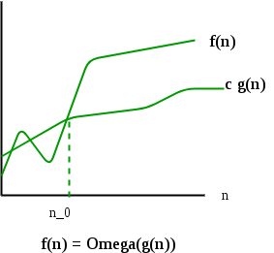
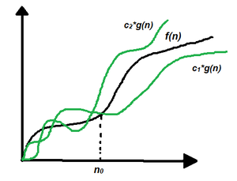
Other Asymptotic Notations for Time/Space Complexity
Mathematical Representation of Omega and Theta
Omega Notation – Ω
it gives the best-case scenario of an algorithm’s complexity, opposite to big-O notation. We can say that: “the amount of Time/space this algorithm takes will grow no more slowly than this fix), but it could grow more quickly.”
Theta Notation – θ
Theta notation encloses the function from above and below. Since it represents the upper and the lower bound of the running time of an algorithm, it is used for analyzing the average-case complexity of an algorithm
Theta (Average Case) You add the running times for each possible input combination and take the average in the average case.

Slide 28
2.1.4 Space Complexity
Space complexity refers to the total amount of memory space used by an algorithm/program, including the space of input values for execution. Calculate the space occupied by variables in an algorithm/program to determine space complexity.The best algorithm/program should have a low level of space complexity. The less space required, the faster it executes.
Notation
There are different notations we can use to express space complexity measurements. The most widely used is
Big-O Notation describes an asymptotic upper bound. It represents the algorithm’s scalability and performance.
It gives the worst-case scenario of an algorithm’s growth rate. We can say that: “the amount of space this algorithm takes will grow no more quickly than this f(x), but it could grow more slowly.”
Let’s see a few examples of expressing space complexity using big-O notation, starting from slowest space growth (best) to fastest (worst):
O(1) – constant complexity – takes the same amount of space regardless of the input size
O(log n) – logarithmic complexity – takes space proportional to the log of the input size
O(n) – linear complexity – takes space directly proportional to the input size
O(n log n) – log-linear/quasilinear complexity – also called “linearithmic”, its space complexity grows proportionally to the input size and a logarithmic factor
O(n^2) – square/polynomial complexity – space complexity grows proportionally to the square of the input size

Slide 29
Analyzing Space Complexity of Algorithms
The ability to calculate space complexity is essential in considering an algorithm’s efficiency. In this section, we’ll analyze the space complexity of a few programs of differing difficulty. We’ll measure it using big-O notation.
Above all, it’s necessary to mention that space complexity depends on a variety of things such as the programming language, the compiler, or even the machine running the algorithm.
We’ll use C++ for our examples, although, each of them could be easily applied to any technology. To apply them to other programming languages, we can simply replace the C++ data types with language-specific ones. Then in our calculations, we’d use the sizes that correspond to the language-specific data types.

Slide 30
Example1: Space Complexity
Consider the simple program that sums two integers (numbers without a fractional part):
int addition(int a, int b) {
return a + b;
}
Copy
In this particular method, three variables are used and allocated in memory:
the first int argument, a
the second int argument, b
and the returned sum result which is also an int like a and b
A single integer variable occupies four bytes of memory. In this example, we have three integer variables. Therefore, this algorithm always takes 12 bytes of memory to complete (3*4 bytes).
We can clearly see that the space complexity is constant, so, it can be expressed in big-O notation as O(1).

Slide 31
Example2: Space Complexity
Determine the space complexity of a program that sums all integer elements in an array.
Let’s list all variables present in the above code:
array – the function’s only argument – the space taken by the array is equal 4n bytes where n is the length of the array
size – a 4-byte integer
sum – a 4-byte integer
iterator – a 4-byte integer
The total space needed for this algorithm to complete is 4n + 4 + 4 + 4 (bytes). The highest order of n in this equation is just n. Thus, the space complexity of that operation is O(n).
#include <iostream>
using namespace std;
int sumArray(int a[], int size) {
int sum = 0;
for (int iterator = 0; iterator < size; iterator++)
{
sum += a[iterator];
}
return sum;
}
int main() {
int arr[5]={10,20,30,40,50};
int size = sizeof(a)/sizeof(a[0]);
cout << "The sum is "<<sumArray(arr,size)<<endl;
return 0;
}

Slide 32
Conclusion
Time Complexity:
Time complexity is a measure of the amount of time an algorithm takes with respect to the size of its input. It helps in understanding how the running time of an algorithm increases as the size of the input increases. The common notations used for denoting time complexity are:

Slide 33
Conclusion(Cont)
O (Big O) Notation: It gives the upper bound of the time an algorithm takes to run, in the worst-case scenario.
Ω (Big Omega) Notation: It gives the lower bound of the time an algorithm takes to run, in the best-case scenario.
Θ (Theta) Notation: It provides an average case time complexity.

Slide 34
Conclusion(Cont)
Common time complexities include:
Constant Time (O(1)): The algorithm's running time is constant and does not depend on the size of the input.
Linear Time (O(n)): The running time of the algorithm increases linearly with the size of the input.
Logarithmic Time (O(log n)): The running time of the algorithm increases logarithmically with the size of the input.
Quadratic Time (O(n^2)): The running time of the algorithm increases quadratically with the size of the input.
Exponential Time (O(2^n)): The running time of the algorithm increases exponentially with the size of the input.

Slide 35
Conclusion(Cont)
2. Space Complexity:
Space complexity refers to the amount of memory space that an algorithm requires to solve a problem. It's a measure of the maximum amount of memory space used by the algorithm for a given problem size. Similar to time complexity, space complexity can also be denoted using Big O notation.

Slide 36
Conclusion(Cont)
It's important to analyze both time and space complexities while evaluating algorithms, as a trade-off between the two may often exist. Choosing the right algorithm involves considering both time and space complexities, along with the specific requirements and constraints of the problem at hand.

Slide 37
Read More
https://www.scholarhat.com/tutorial/datastructures/complexity-analysis-of-data-structures-and-algorithms
https://www.geeksforgeeks.org/complete-guide-on-complexity-analysis/
https://thegeekplanets.medium.com/the-ultimate-guide-to-complexity-analysis-in-data-structures-and-algorithms-c4f9be147a54

Slide 38
2.2 Introduction to Data Structure analysis

Slide 39


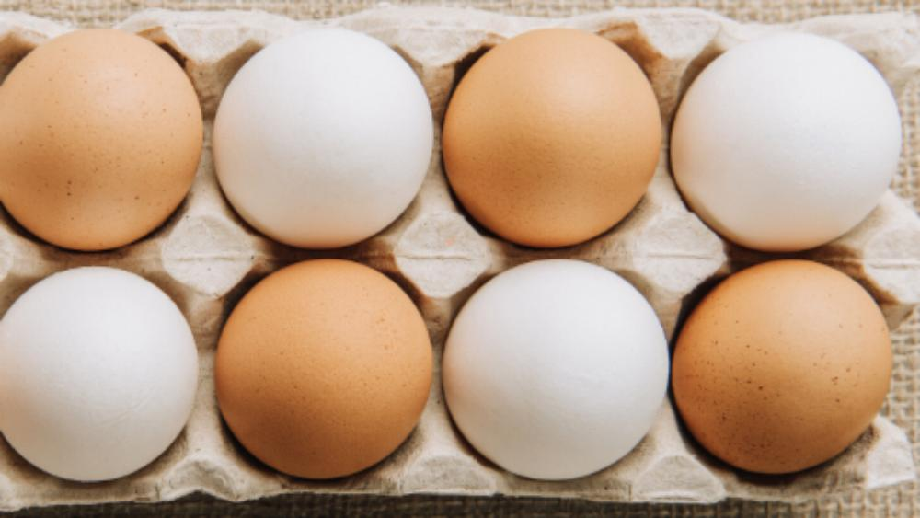


Observe the figures and describe what you see;

Slide 40
2.2.1 Introduction to Data Structures
Data Structure is a logical or mathematical model for collecting and organizing data in such a way that we can perform operations on these data in an effective way. Data Structures is about rendering data elements in terms of some relationship, for better organization and Storage.
Example: Library is composed of elements (books) to access a particular book requires knowledge of the arrangement of the books.
If we arrange some data in appropriate sequence, then it forms a Structure and gives us a meaning. This meaning is called information. The basic unit of information in computer Science is a bit, binary digit. So we found two things in information: One is Data and the other is Structure

Slide 41
Relationship between Data Structures vs Algorithms
Data structures and algorithms are two interrelated concepts in computer science. Data structures refer to the organization, storage, and retrieval of data, while algorithms refer to the set of instructions used to solve a particular problem or perform a specific task.
Data structures provide a framework for storing and accessing data that algorithms can operate on.
Data structures and algorithms are often used together to create efficient and effective software solutions. For example, a sorting algorithm can be used to sort data in an array, while a search algorithm can be used to find a particular item in a linked list.
Efficient data structures and algorithms are critical to the performance of software systems. The choice of data structure and algorithm depends on the type of data being processed and the nature of the problem to be solved. By selecting the most appropriate data structure and algorithm, software developers can create high-performance solutions that are both efficient and effective.

Slide 42
Difference and Relationship between Data Structures vs Algorithms
Aspect | Data Structures | Algorithms
Definition | The way data is organized, stored, and retrieved | A set of instructions used to solve a specific problem
Purpose | Provides an efficient way to organize and store data for easy retrieval and modification | Provides a systematic approach to solving problems by breaking them down into smaller, more manageable steps
Operations | Insertion, Deletion, Search, Update, Traverse, etc. | Sorting, Searching, Optimization, Pathfinding, etc.
Importance | Essential for efficient data storage and retrieval | Crucial for developing efficient software solutions
Relationship | Data structures provide a framework for storing and accessing data that algorithms can operate on | Algorithms often operate on data structures to process or manipulate data
Performance | The efficiency of data structures determines the efficiency of algorithms that operate on them | The choice of algorithm can have a significant impact on the performance of the software solution
Examples | Array, Linked List, Stack, Queue, Tree, Graph, Hash Table, etc. | Sorting, Searching, Graph Traversal, Dynamic Programming, Divide and Conquer, etc.

Slide 43
Relationship between Data Structures vs Algorithms Time Complexity
Data structures are the foundation of efficient algorithms and play a crucial role in determining the time complexity of a piece of code.
Different data structures may have different time and space complexity characteristics for various operations, which can impact the performance of an algorithm. Time complexity refers to the amount of time it takes for an algorithm to complete, and it is a measure of how the runtime of an algorithm grows as the input size increases.
The choice of data structure is often determined by the specific algorithm being implemented and can significantly impact the time complexity of a solution, making it faster or slower.
Example: Arrays are the simplest and most basic data structure. They are contiguous blocks of memory that store elements in a linear fashion. Accessing, inserting, and deleting elements from an array have a constant time complexity of O(1), meaning the time taken is independent of the size of the array. However, inserting or deleting elements from the middle of an array can be expensive, as it requires shifting all the elements after the insertion or deletion point.

Slide 44
2.2.2 Abstract Data Type
An abstract data type (ADT) is a logical description of the data and its operations. An ADT is known as a user's point of view of data. An ADT is concerned about the possible values of data and interfaces exposed by it. An ADT is not concerned about the actual implementation of the data structure.
Abstract Data Type is a mathematical model of a data structure that specifies the type of data stored, the operations supported on them and the types of parameters of the operations with no implementation. Each programming language has its own way to implement abstract data type.
Differently to Data structures, Data Structures are a concrete representations of data and implementation.
Data structures serve as the basis for abstract data types (ADT). The ADT defines the logical form of the data type. The data structure implements the physical form of the data type
For example:
A user wants to store some integers and find their mean value. ADT for this data structure would have two functions, one for adding integers and another to get the mean value. ADT for this data structure does not talk about how exactly it will be implemented .ADT is more of a logical description,
Each programming language has its own way to implement abstract data type.

Slide 45
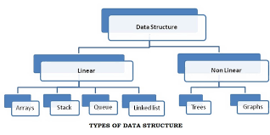
2.2.3 Basic types of Data Structures
Anything that can store data can be called as a data structure, hence Integer,
Float, Boolean, Char etc., all are data structures. They are known as Primitive Data Structures. And we also have some complex Data Structures, which are used to store large and connected data and are called non primitive data structure or Abstract Data Structure. Example: Array, Linked List, Tree, Graph, Stack, Queue etc

Slide 46
Linear vs No-linear
A linear data structure is a type of Data Structure where the data elements get linearly or sequentially arranged. The elements attach themselves to their next and previous adjacents. The structure involves only a single level- allowing a user to traverse all its components in a single run.
The linear data structure is very easy to understand and implement due to its linear arrangement, for example, stack, array, linked list, queue, etc.
Non-Linear Data Structure is a form of data structure where the data elements don’t stay arranged linearly or sequentially. Since the data structure is non-linear, it does not involve a single level. Therefore, a user can’t traverse all of its elements in a single run.
The non-linear data structure is not very easy to implement as compared to the linear data structure. The utilization of computer memory is more efficient in this case, for example, graphs and trees.

Slide 47
Linear vs No-linear
Parameter | Linear Data Structure | Non-Linear Data Structure
Arrangement | In a linear data structure, the data elements connect to each other sequentially. | The data elements connect to each other hierarchically.
Complexity of Implementation | The linear data structures are comparatively easier to implement. | The non-linear data structures are comparatively difficult to implement and understand
Levels | A user can find all of the data elements at a single level in a linear data structure. | One can find all the data elements at multiple levels in a non-linear data structure.
Traversal | You can traverse a linear data structure in a single run. | The users need multiple runs to traverse them completely.
Utilization of Memory | It is not very memory-friendly. It means that the linear data structures can’t utilize memory very efficiently. | The data structure is memory-friendly. It means that it uses memory very efficiently.
Complexity of Time | The time complexity of this data structure is directly proportional to input size. | Time complexity often remains the same with an increase in its input size.
Applications | Linear data structures work well mainly in the development of application software. | Non-linear data structures work mainly well in image processing and Artificial Intelligence.
Examples | List, Array, Stack, Queue. | Map, Graph, Tree.

Slide 48
2.2.4 Importance of data structures
The data structures have the following importance for programming:
Data structures study how data are stored in a computer so that operations can be implemented efficiently
Data structures are especially important when there is a large amount of information to deal with.
Data structures are conceptual and concrete ways to organize data for efficient storage and manipulation

Slide 49
2.2.5 Data Structure Operations
Beside the simple operations performed on data (unary operators, binary operators and precedence operators) seen previously, the data appearing in our data structures are processed by means of other operations.
The following are some of the most frequently used operations.
Traversing: Accessing each record exactly once so that certain items in the record may be processed.
Searching: Finding the location of the record with a given key value or finding the locations of all records which satisfy one or more conditions
Inserting: Adding a new record to the structure.
Deleting: Removing a record from the structure.
Sorting: Arranging the records in some logical order (e.g., in numerical order according to some NUMBER key, such as social security number or accountnumber).
Merging: Combining the records of two different sorted lists into a single sorted list.

Slide 50
Array
Arrays are the simplest data structures that store items of the same data type.
Array ADT Operations
Below is the API of an array:
1. Adds an element at the kth position. Value can be stored in an array at the kth position in 0(1) constant time. We just need to store value at arr[k].
2. Reading the value stored at the kth position. Accessing the value stored at some index in the array is also O(1) constant time. We just need to read the value stored at arr[k].
3. Substitution of value stored in kth position with a new value.
4. Time complexity: O(1) constant time.
Example:
int main() {
}
int arr[10];
int size= sizeof(arr) / sizeof(int);
for (int i = 0; i< size; i++) {
arr[i] = i;
}
for (int i = 0; i < size; i++) {
printf("%d ", arr[i]);
}
return 0;
}
Output:
0 1 2 3 4 5 6 7 8 9
Applications of Arrays are:
1. Storing data in tabular format.
2. Used in the creation of Matrices.
3. Used in the creation of various higher level data structures like Stacks, Queues, Heaps, HashTables etc.
Note: Problems based on array data structure are discussed later, especially in the Sorting and Searching topics

Slide 51
Other Abstract Data Structures
In coming learning units, apart from Array, will be studying various data structures and their API so that the user can use them and their internal implementation.
These include Linked List,Stacks, Queues, Heaps, Hash Tables, Tree, Graph, Hash Table among the others.

